Slide 1
IDENTIFY PATTERNS AND TRENDS IN CAMPUS PLACEMENT DATA USING MACHINE LEARNING

Slide 2
Description
The aim of models help you to make a trend analysis of university placements data, to predict a placement rate for the students of an upcoming year which will help the university to analyze the performance during placements. Many students look at universities as a means of investment which can help them make a great future by getting placed in good companies.The data can used to predict the future Campus Placement being admitted .

Slide 3
PROJECT FLOW
03
01
02
04
05
DATA COLLECTION:
VISUALIZING AND ANALYZING DATA
DATA PRE-PROCESSING
1. Collect the dataset or create the dataset.
Univariate
Bivariate
Multivariate
Decriptive
Checking null values
Handling outlier
Splitting data into test and train
MODEL BUILDING
Import the moel building libraries
Initializing the model
Evaluating performance of model
APPLICATION BUILDING
1. Create an HTML file
2. Build python code

Slide 4
Data Collection & Preparation
Data Collection steps:
1. Identify issues or opportunities for collecting data.
2. Select issue or opportunity and set goals.
3. Plan an approach and methods.
4. Collect data.
5. Analyze and interpret data.
6. Act on results.
Data preparation steps:
1. Gather data.
2. Discover and assess data.
3. Cleanse and validate data.
4. Transform and enrich data.
5. Store data.

Slide 5
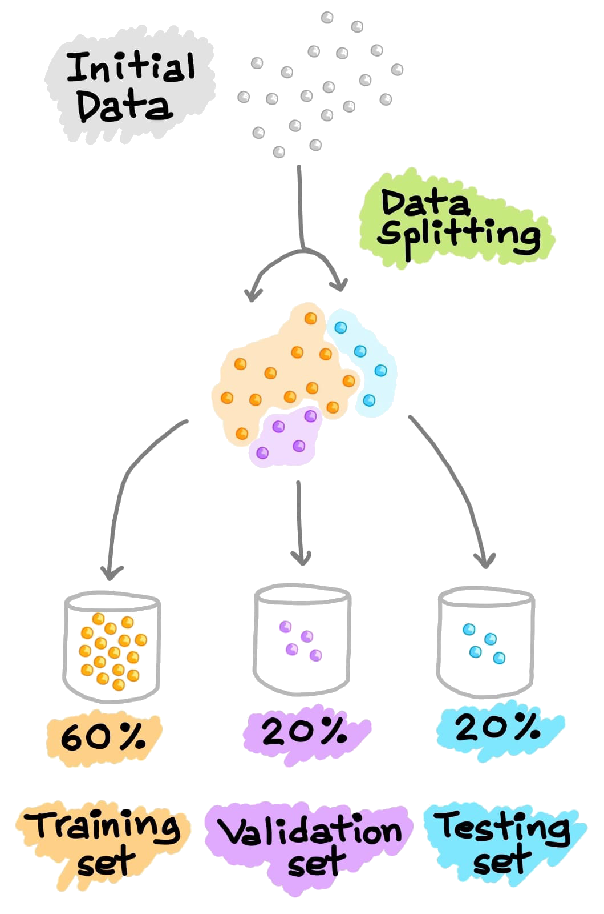
MODEL BUILDING
Define the purpose of your model.
Determine the model boundary.
Map the model.
Build the model.
Test the model.
Create an interface

Slide 6
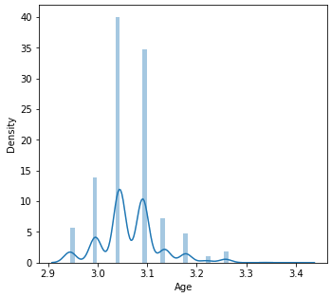
Exploratory Data Analysis
Univariate graphical.
Multivariate graphical
Univariate non-graphical
Multivariate non-graphical
Mercury
Exploratory data analysis (EDA) is an approach to analyzing datasets to summarize their main characteristics, often with visual designs, such as tables, charts, and graphs.
Venus

Slide 7
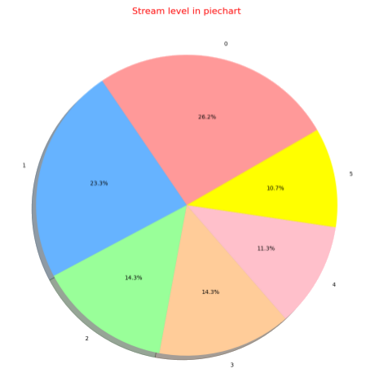
Performance Testing & Hyper Tuning
Mars
Venus has extremely high temperatures
Venus
1. Select the right type of model.
2. Review the list of parameters of the model and build the HP space.
3. Finding the methods for searching the hyperparameter space.
4. Applying the cross-validation scheme approach.Assess the model score to evaluate the model.
Saturn
Saturn is a gas giant and has several rings
Jupiter
Jupiter is the biggest planet of them all

Slide 8
Model Deployment
Model deployment is the process of putting machine learning models into production, where it can make predictions based on data. Users, developers, and systems then use these predictions to make practical business decisions.
Step 1: Create a new virtual environment using Pycharm IDE.
Step 2: Install necessary libraries.
Step 3: Build the best machine learning model and Save it.
Step 4: Test the loaded model.
Step 5: Create main.py file.

Slide 9
Conclusion :
This system is beneficial for institutions to predict student's campus placement and placement officers can work on identifying the weakness of each student.Algorithms like random forest and KNN will give maximum accuracyto the prediction.
Notes:
efi

Slide 10

THANK YOU

